Slide 1
Transit Gateway
Presented by:-
Aman Sindhu | AMS
Deeksha Arora | AMS
Sonam Jain | AMS
Puneet Uttam | AMS

Slide 2
Contents
Introduction of Transit Gateway
Advantage of VPC peering
Disadvantage of VPC peering
VPC Peering Architecture
Advantages of Transit gateway over VPC peering
Transit Gateway Architecture
Disadvantages of Transit Gateway
Provisioning & Architecture

Slide 3
Transit Gateway Features
Transit gateway is a network transit hub that we can use to interconnect the virtual private clouds (VPCs) and on-premises networks. As cloud infrastructure expands globally, inter-Region peering connects transit gateways together using the AWS Global Infrastructure.
Transit gateway is a fully-managed service for connecting multiple Amazon Virtual Private Clouds (VPCs) and on-premises networks through a single gateway.
Simplifies network architecture, reduces operational overhead, and scales networks as they grow.
Supports advanced networking features such as routing policies, network segmentation, and security controls.
Allows connection to other AWS services such as Amazon S3, Amazon DynamoDB, and Amazon EC2 instances and so on in a different VPC.
Monitoring and Security is much more advance in Transit Gateway as we can use CloudWatch for monitoring and AWS IAM to manage access to AWS Transit Gateway securely.

Slide 4
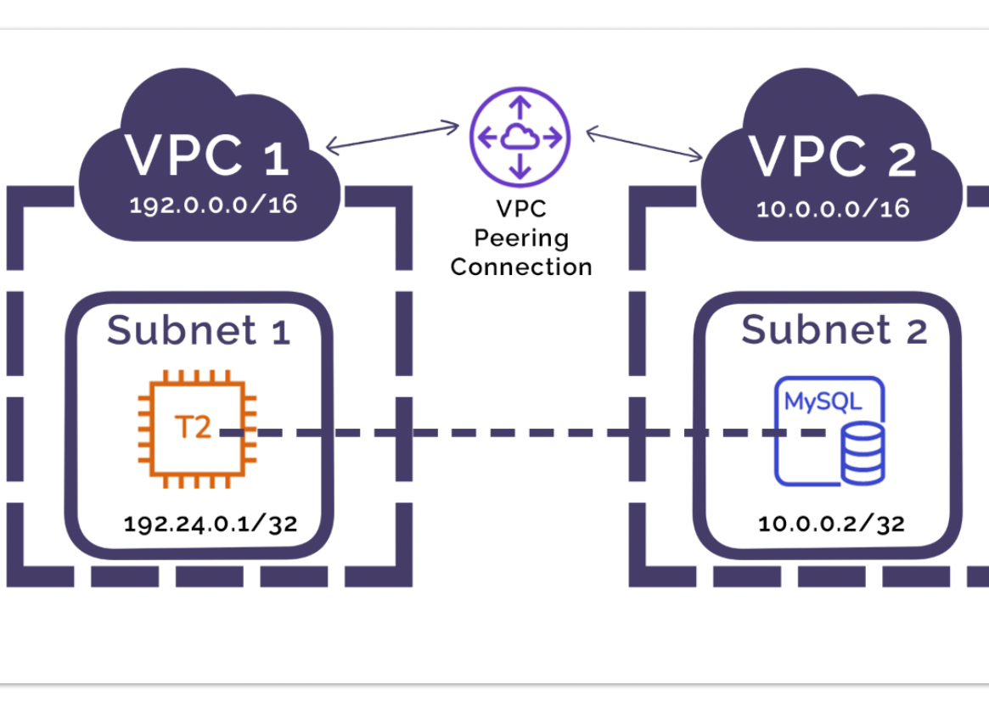
Advantages of VPC peering
Priced only on data transfer
No bandwidth limit
Low Latency

Slide 5

Disadvantages of AWS VPC peering
Each VPC increases the complexity of the network - n(n-1)/2
For ex. - 6(6-1)/2=15
Limited visibility (only VPC flow logs) compared to TGW
Harder to maintain route tables compared to TGW

Slide 6
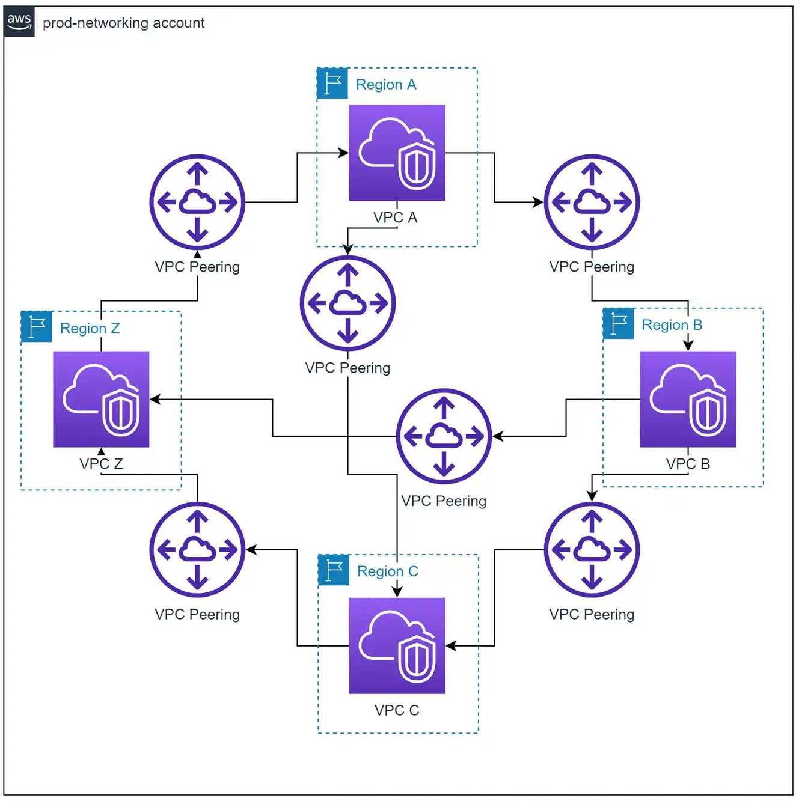
VPC Peering Architecture

Slide 7
Advantages of Transit gateway over peering
Scale
Centralized management
Multi-account and multi-region support
Advanced networking features
Monitoring

Slide 8
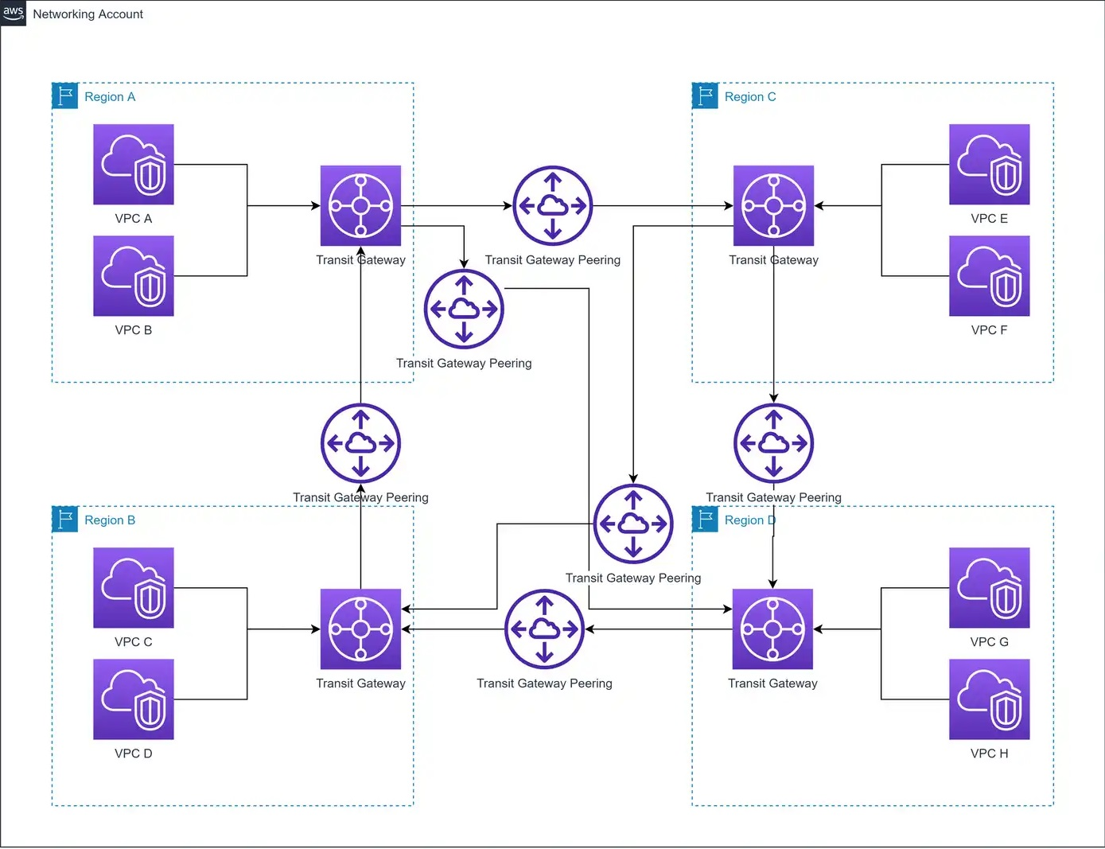
Transit Gateway Architecture

Slide 9

Disadvantages of Transit Gateway
Additional hop will introduce some latency
TGW connect peer support a maximum (non-adjustable) limit of 5,000,000 (5 Gbps) packets per second
Priced on hourly cost per attachment($0.05), data processing($0.02), and data transfer
Transit gateway does not support DNS resolution for custom DNS names of attached VPCs set up using private hosted zones in Amazon Route 53

Slide 10
Provisioning of Infrastructure for TGW
Provisioning of vpc
Provision of ec2 instance and security group
Provisioning of Transit Gateway
Modify Security group
Modify VPC route table
Ssh and Telnet

Slide 11
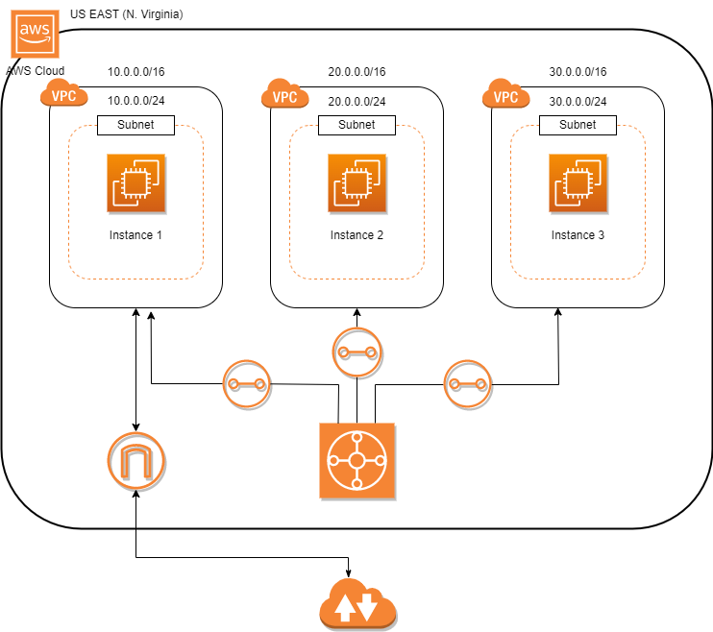
Transit Gateway Architecture

Slide 12

Thank You

